Slide 1
Title :- Sales Dashboard
Subtitle :- Business Summary using Tableau
Presented by :- Ganesh R. Badgujar

Slide 2
Introduction
Purpose of the Dashboard: This Tableau dashboard is designed to provide a comprehensive overview of business sales performance. It helps stakeholders:
Monitor key performance indicators (KPIs) like Total Sales, Boxes Shipped, and Shipment Count
Understand sales distribution by country
Identify the top-performing salespersons

Slide 3
Objective
Objective of the Dashboard:
Visualize overall sales performance
Track boxes shipped and shipment count
Analyze sales by country
Identify top-performing salespersons

Slide 4
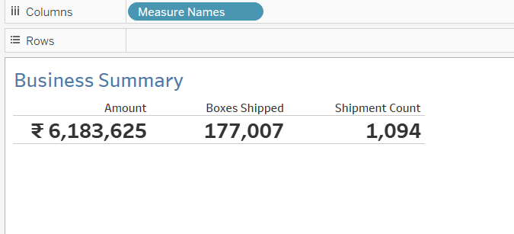
Key Metrics
Business Summary:
Total Sales Amount: ₹6,183,625
Total Boxes Shipped: 177,007
Total Shipments: 1,094 These KPIs give a quick overview of business performance.

Slide 5
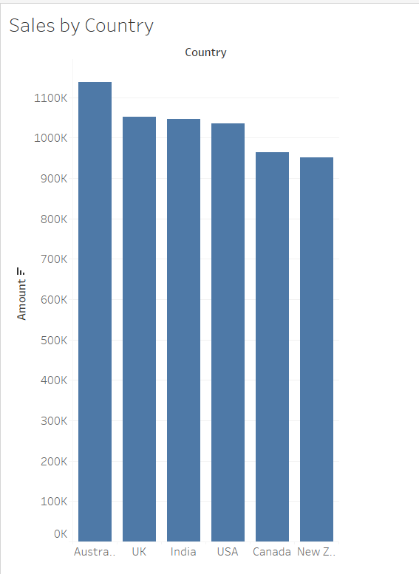
Sales by Country
Insights:
Highest sales from Australia
Followed by UK, India, and USA
Helps identify strong market regions

Slide 6
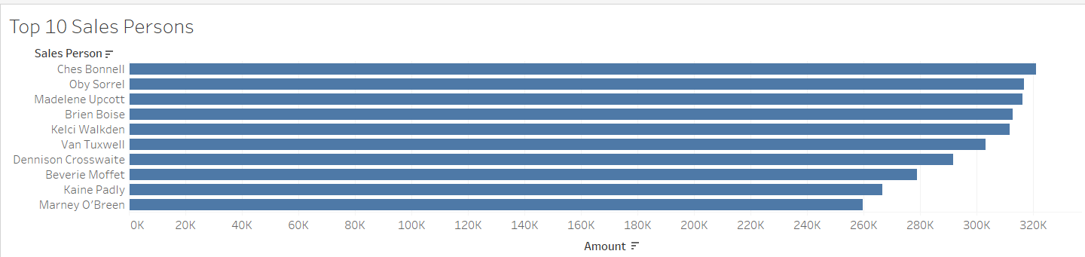
Top 10 Sales Persons
Insights:
Ches Bonnell and Oby Sorrel are top performers
Consistent performance from the top 10 contributes significantly to total revenue
This helps reward and encourage top contributors

Slide 7
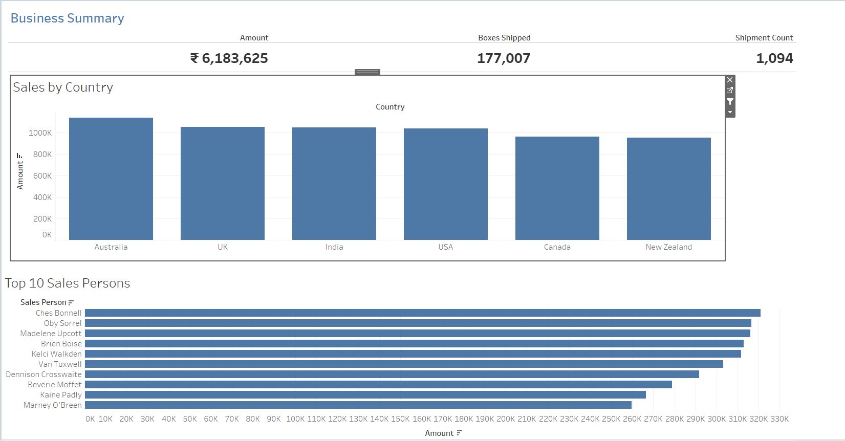
Dashboard

Slide 8
Conclusion
Tableau helps in real-time sales monitoring
Enables data-driven decision-making
Highlights both strong markets and high-performing individuals

Slide 9


